Slide 1

Hospital Management System
Hithai Shree J
Prasanna Lakshmi
Anuhya Muddanur
Mounika K
GitHub Link: https://github.com/hithaishree/HospitalManagement

Slide 2
Contents
Introduction
System Need
Software & Database Requirement Specification
Modules
Project Screenshots.
Advantages & Disadvantages
Conclusion

Slide 3
Existing System Issues
Features of Proposed System
-paper based
-inappropriate data keeping
-time wastage in storage, retrieval
-patients were unable to understand
the prescription
-Separate user account for doctors
and other staff.
-Keeps each patient’s data separate,
easy to track
-Easy user interface

Slide 4
System Needs
To keep track of hospitals day-to-day activities & records of its patients, doctors that keep the hospital running smoothly & successfully there is need of Hospital management System.
To digitalize all the version of the manual system.
To provide a paper-less hospital up to 90%, i.e. To provide low-cost reliable digitalization of the existing systems
To digitalize, the process of day-to-day activities like Registering New Patient, Assigning a Doctor to new patient, Adding new staff members, and finally compute the bill etc.
To provide excellent security of data at every level of user-system interaction and also to provide robust & reliable storage facility.

Slide 5

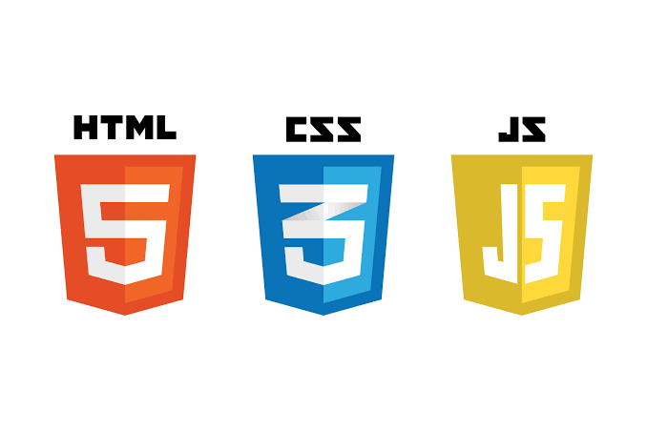





Technologies Used

Slide 6
Software Requirement Specifications
Content | Description
Front End | HTML, CSS, JavaScript, Hibernate, Spring Boot.
Back End | MySQL workbench 8.0.23CE.
Middleware/Server | Apache Tomcat v8.5. IDE: Eclipse IDE for Java EE Developers
Processors | i3,i5,i7
Hard Drive | 1GB(minimum) , 2GB(Recommended)
RAM | 512MB(minimum), 1GB(Recommended)
Browser | Google Chrome
Operating System | Windows 10,Windows 7,Windows 8

Slide 7



MODULES
USER Module
ADMIN Module
DOCTOR Module

Slide 8
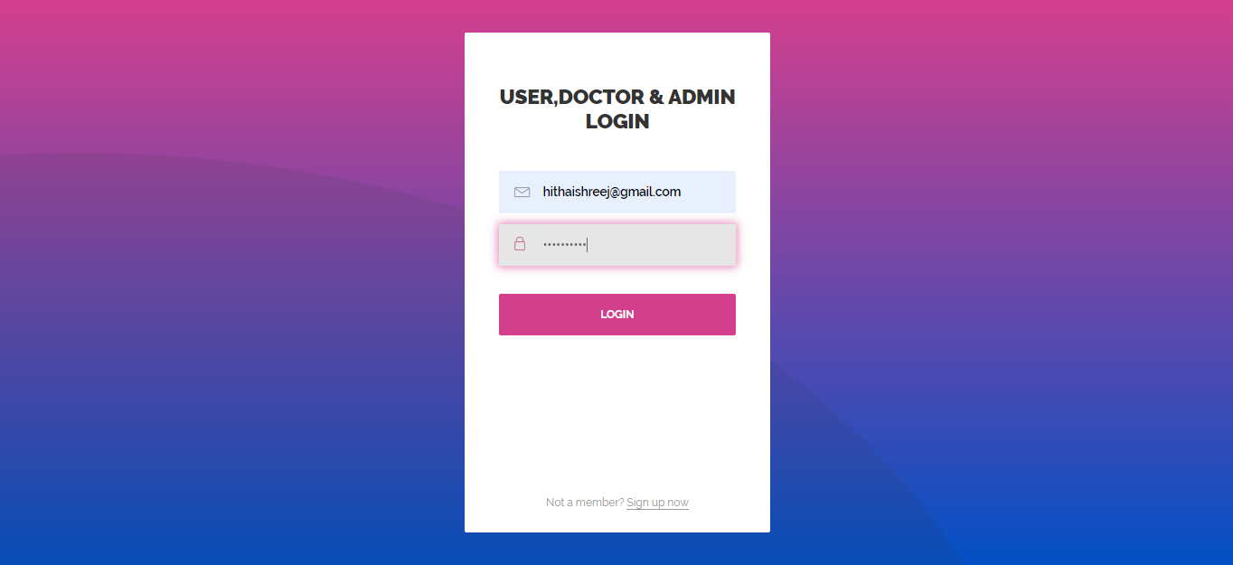
USER , Doctor & Admin PAGE

Slide 9
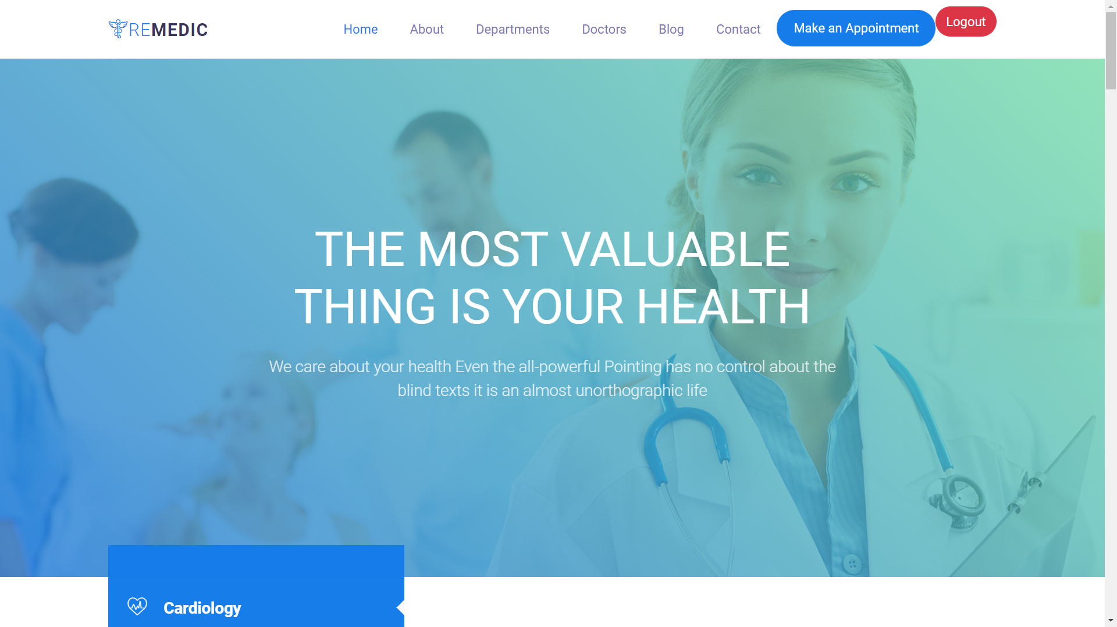
home PAGE

Slide 10
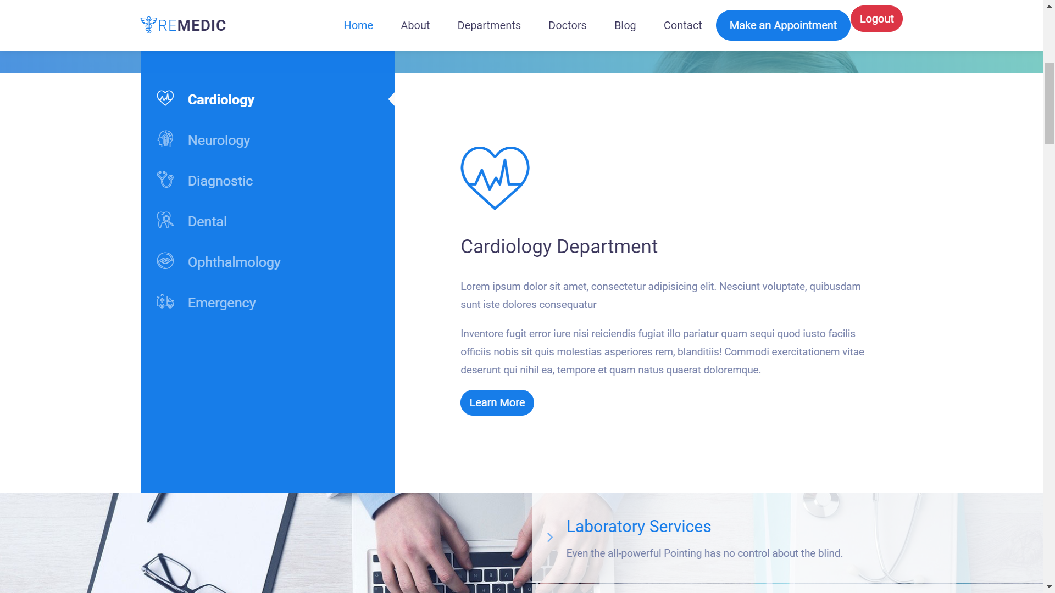
home PAGE

Slide 11
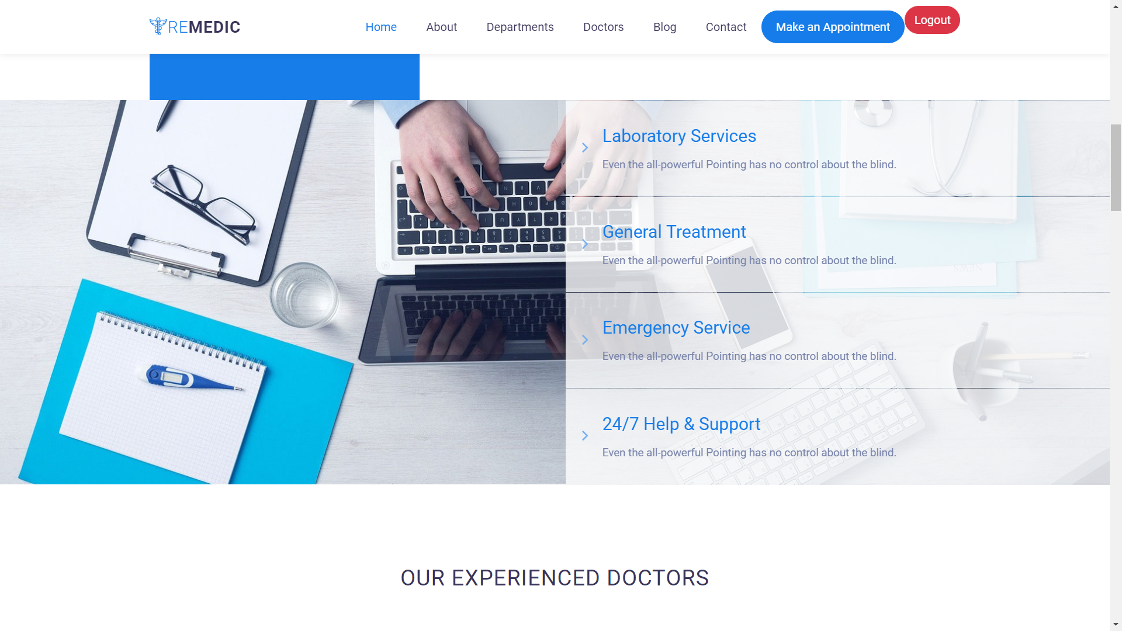
home PAGE

Slide 12
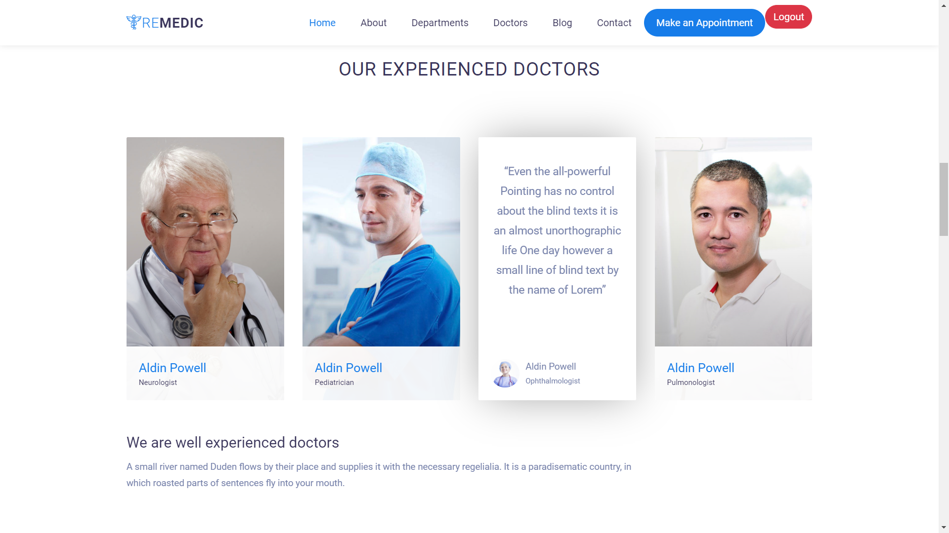
home PAGE

Slide 13
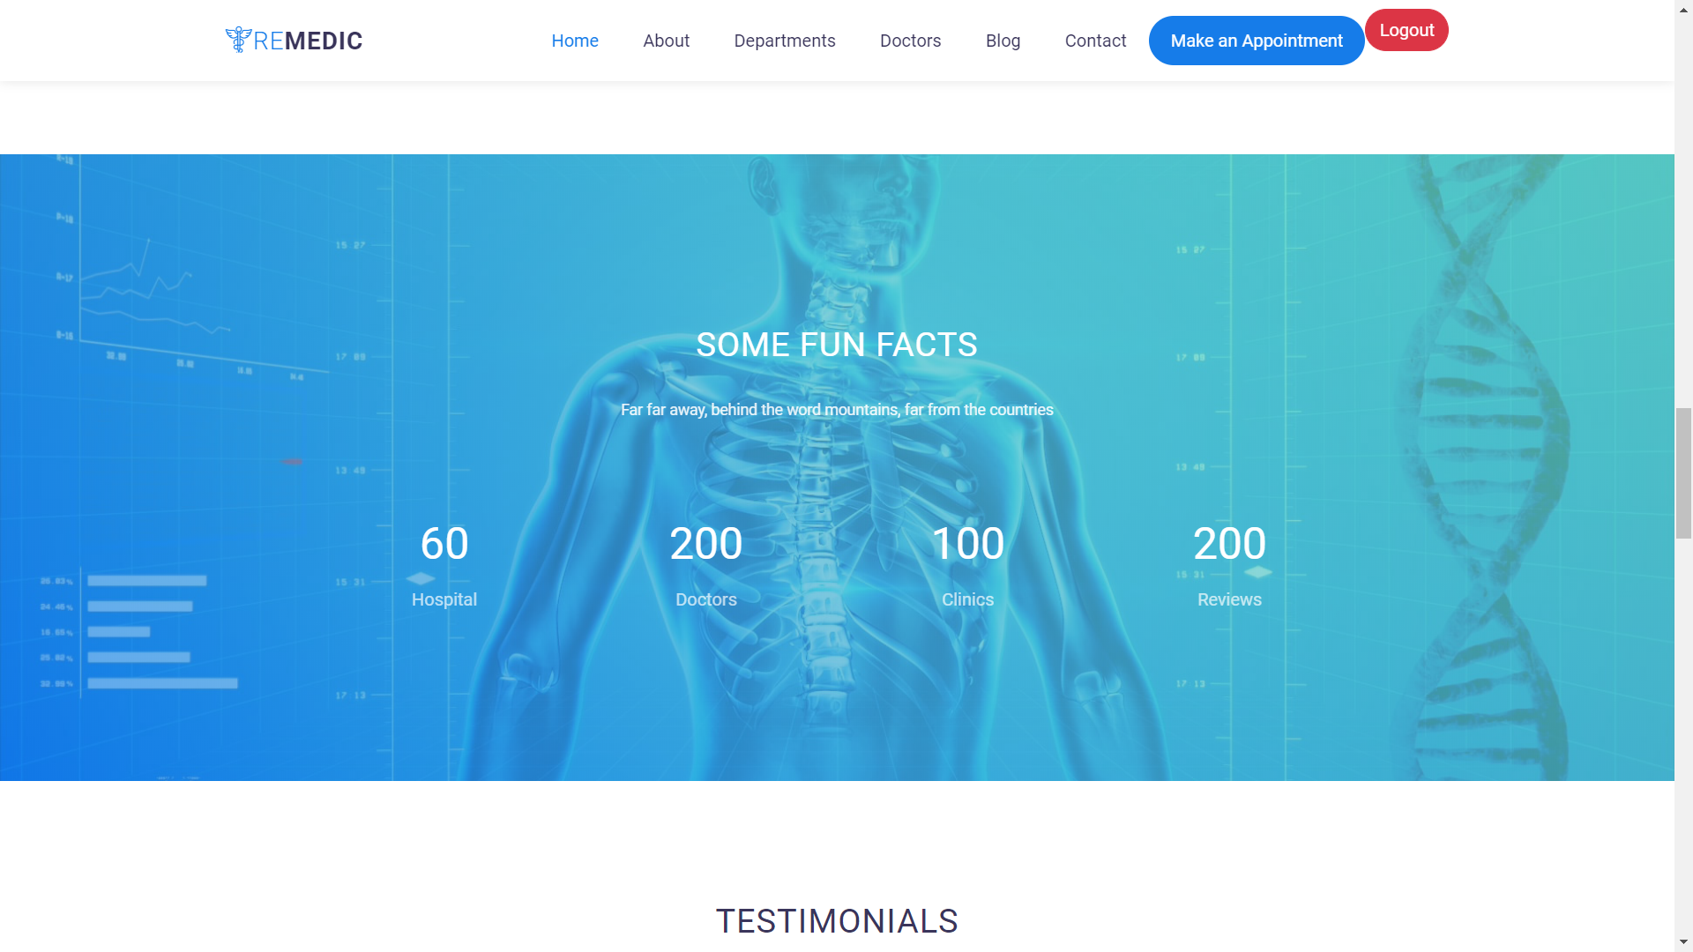
home PAGE

Slide 14
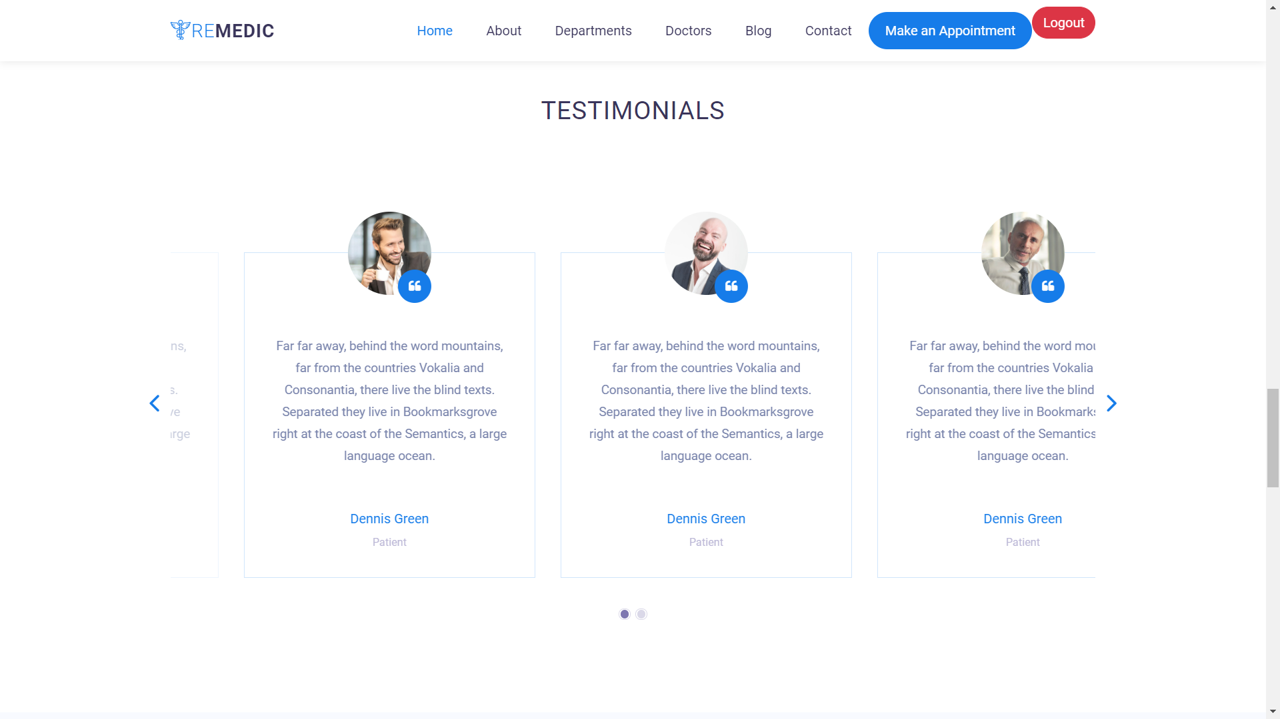
home PAGE

Slide 15
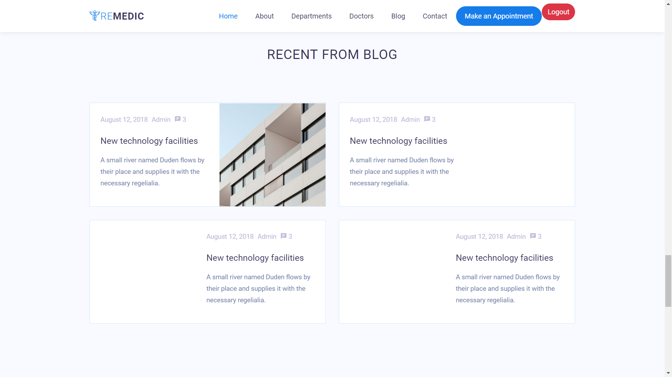
home PAGE

Slide 16
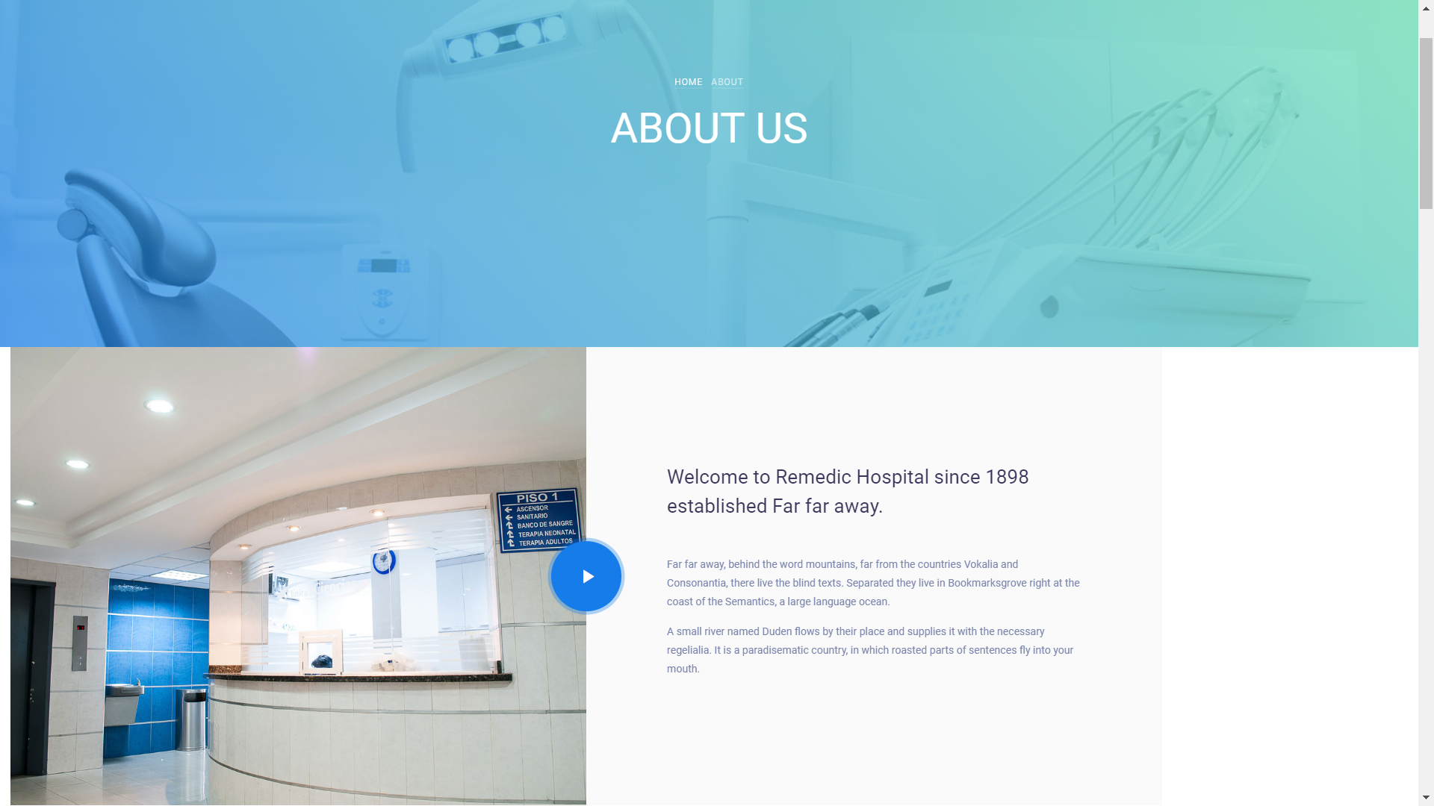
About us PAGE

Slide 17
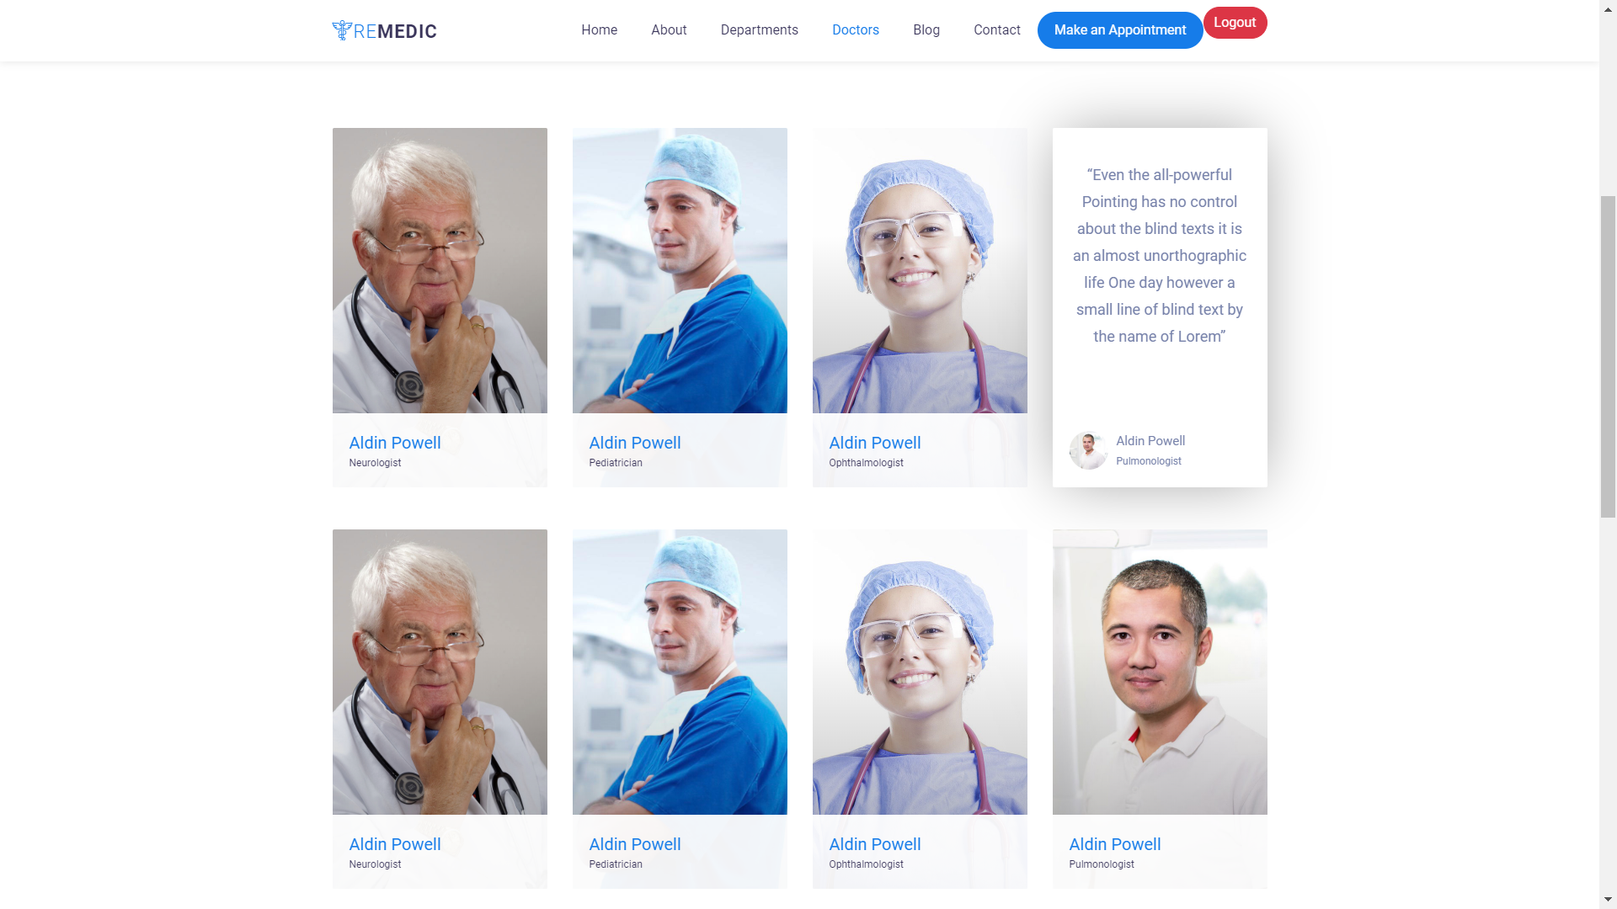
Doctor PAGE

Slide 18
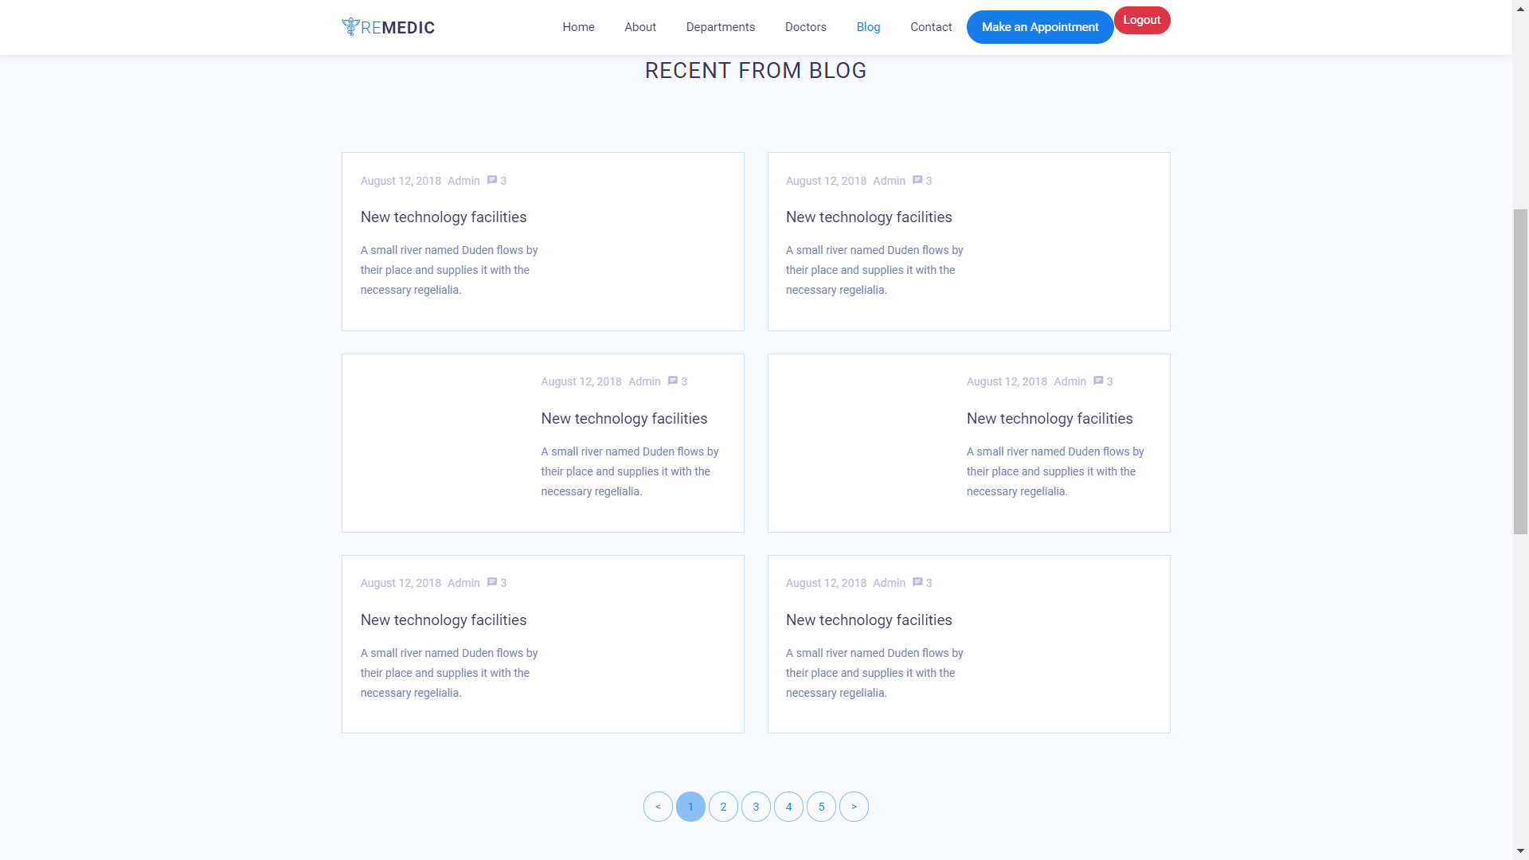
BLOG PAGE

Slide 19
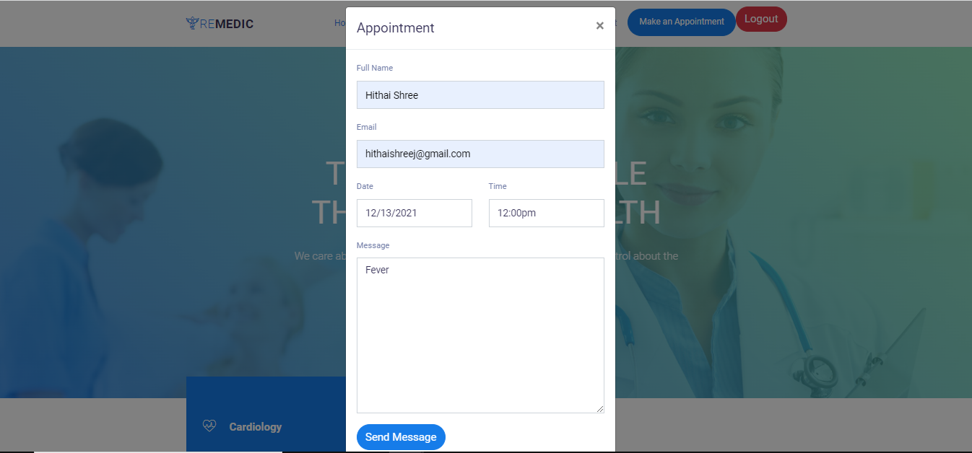
USER Appointment PAGE

Slide 20
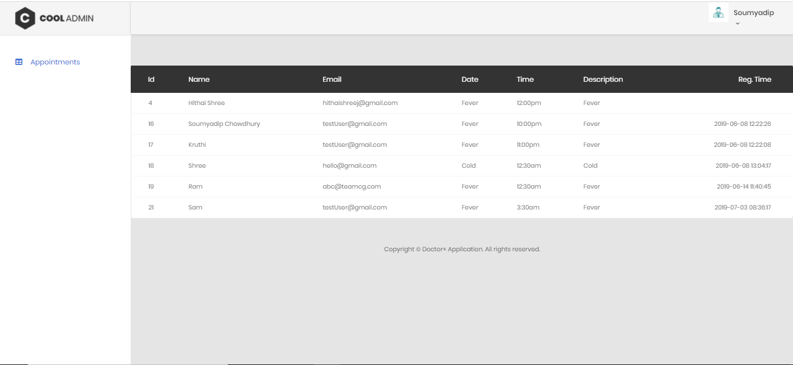
DOCTOR LOGIN PAGE

Slide 21
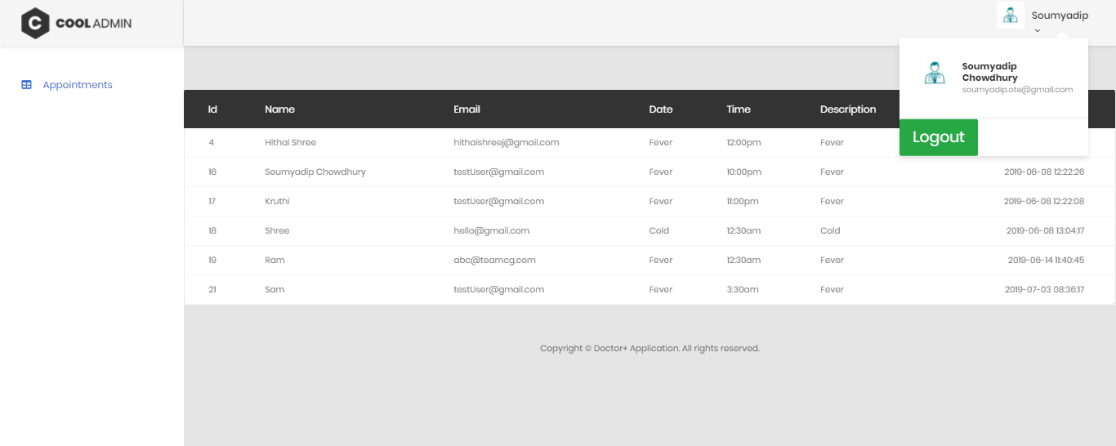
DOCTOR LOGOUT PAGE

Slide 22
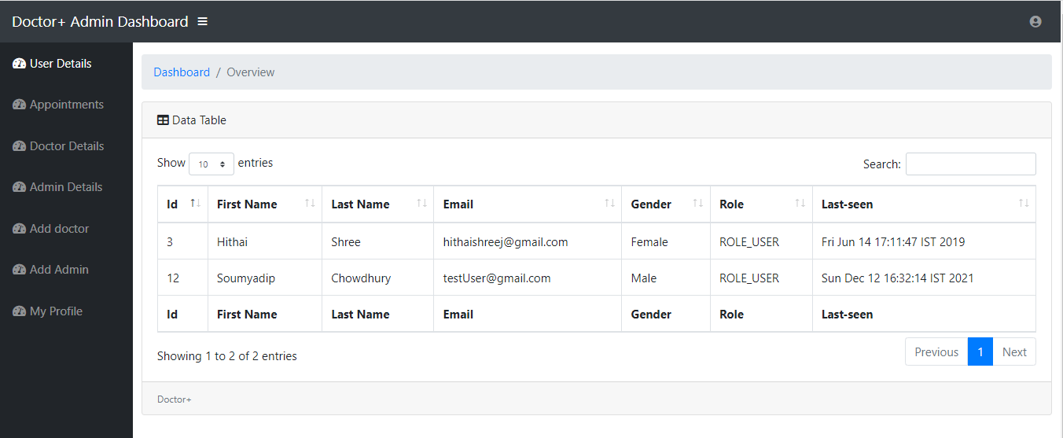
USER DETAILS PAGE

Slide 23
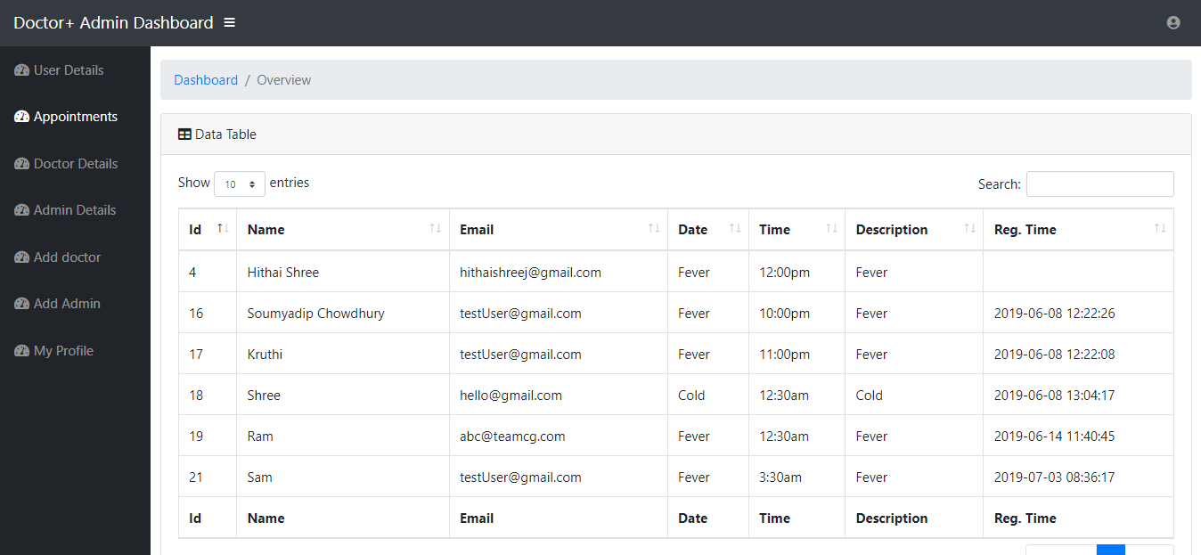
APPOINTMENTs PAGE

Slide 24
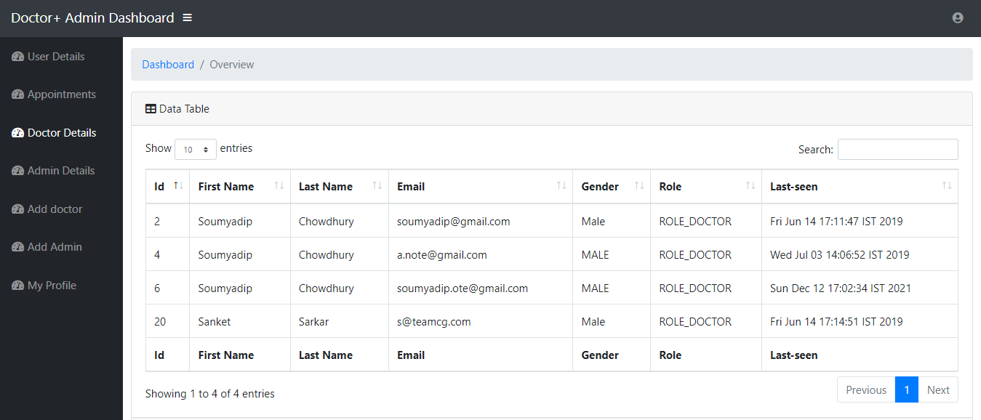
DOCTOR DETAILS PAGE

Slide 25
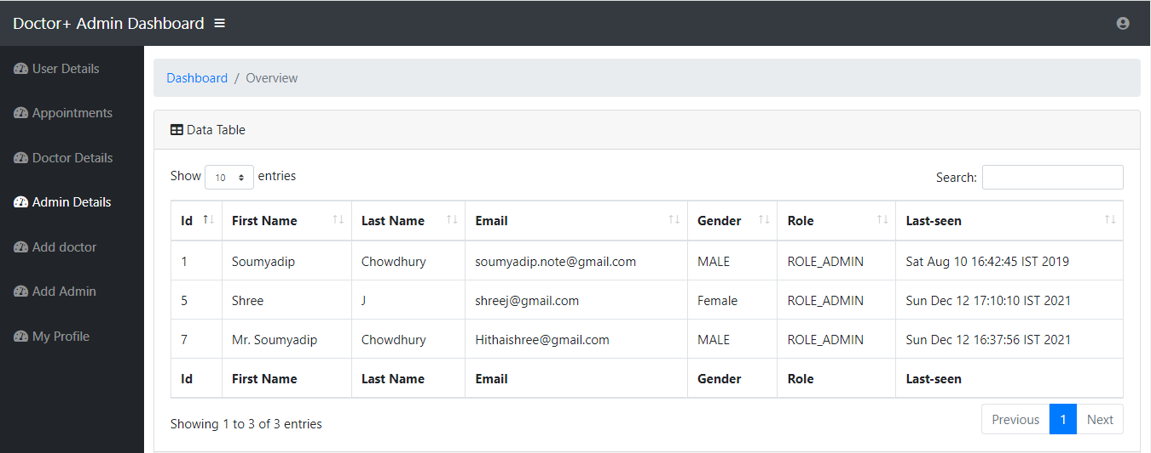
ADMIN DETAILS PAGE

Slide 26
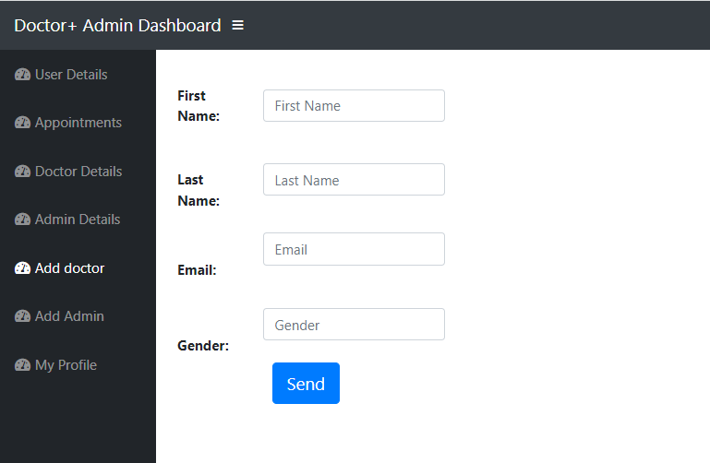
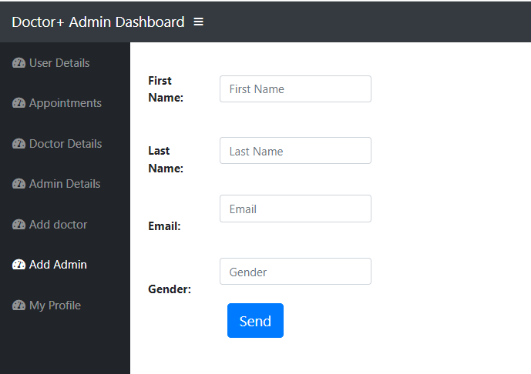
ADD ADMIN Page
ADD DOCTOR Page

Slide 27
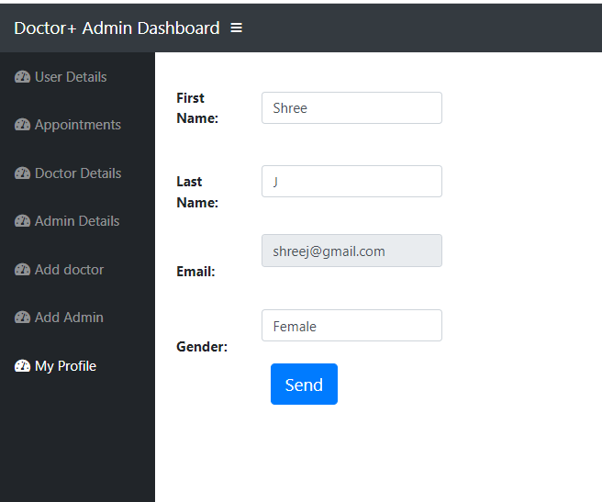
MY PROFILE PAGE

Slide 28
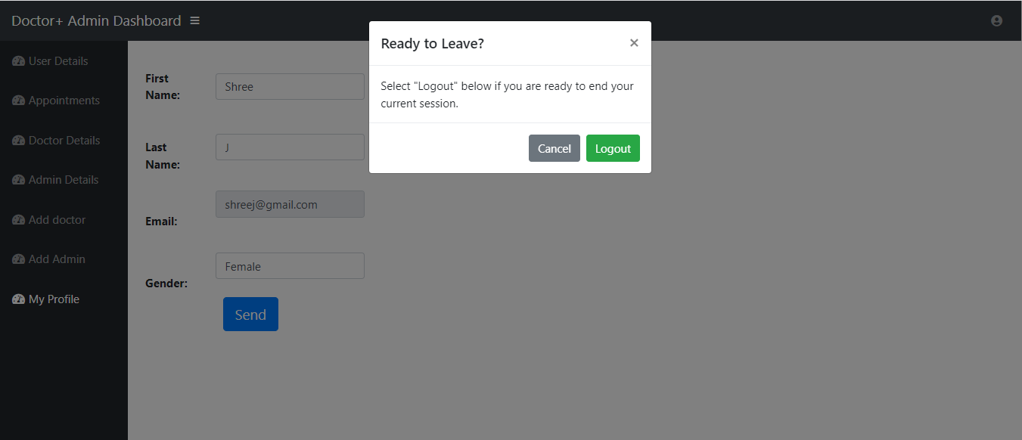
LOGOUT PAGE

Slide 29
Advantages and Disadvantages
Advantages:
Makes prescription readable and understandable to patients.
Eliminate redundancy in term of data storage.
Reduce the time wasted in retrieving data i.e. in finding a past health records.
Increase Efficiency and Interactivity in any area of specialization in the hospital.
Able to quickly collect and edit data ,summarize results.
Disadvantages:
Patients don’t have any role.
No Live Queue feature.

Slide 30
Conclusion
This project helps in making paperless activities. It reduces the workload from Doctor and Receptionist.
It provides more ease and flexibility to from Doctor, Administrator and Receptionist.
This digitalization has reduce costs of Hospital.
This work has created a little awareness and promotes the idea that the concept of paperless office is reality.

Slide 31
Thank You !

